Slide 1
Modeling Integrated Community Energy and Harvesting Systems from Databases using OpenModelica
Data Transfer from MySQL Databases into OpenModelica Models
James LeMoine, Vick Lakhian, Jim Cotton
28

Slide 2




Database information
Integrated Community Energy Systems – A Whole Systems Approach
Thermal Energy Generation
Electrical
Generation
Thermal Energy Storage
Electrical
Storage
28
Notes:
Integrated community energy systems are a whole systems approach that combines both thermal and electrical generation and storage to create a shared energy economy. They’re ideal for high density communities that have mixed use facilities, and to better understand how they fit into the energy landscape, some background is required. Starting with how energy is currently produced and transmitted to the developed world.

Slide 3
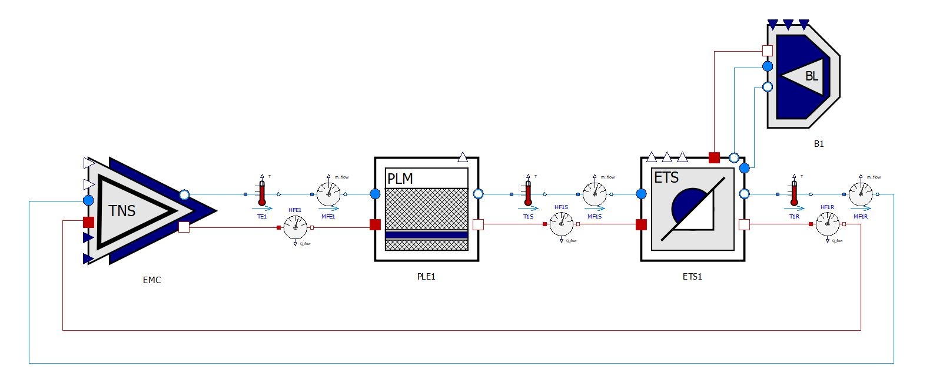
Modelica
6

Slide 4
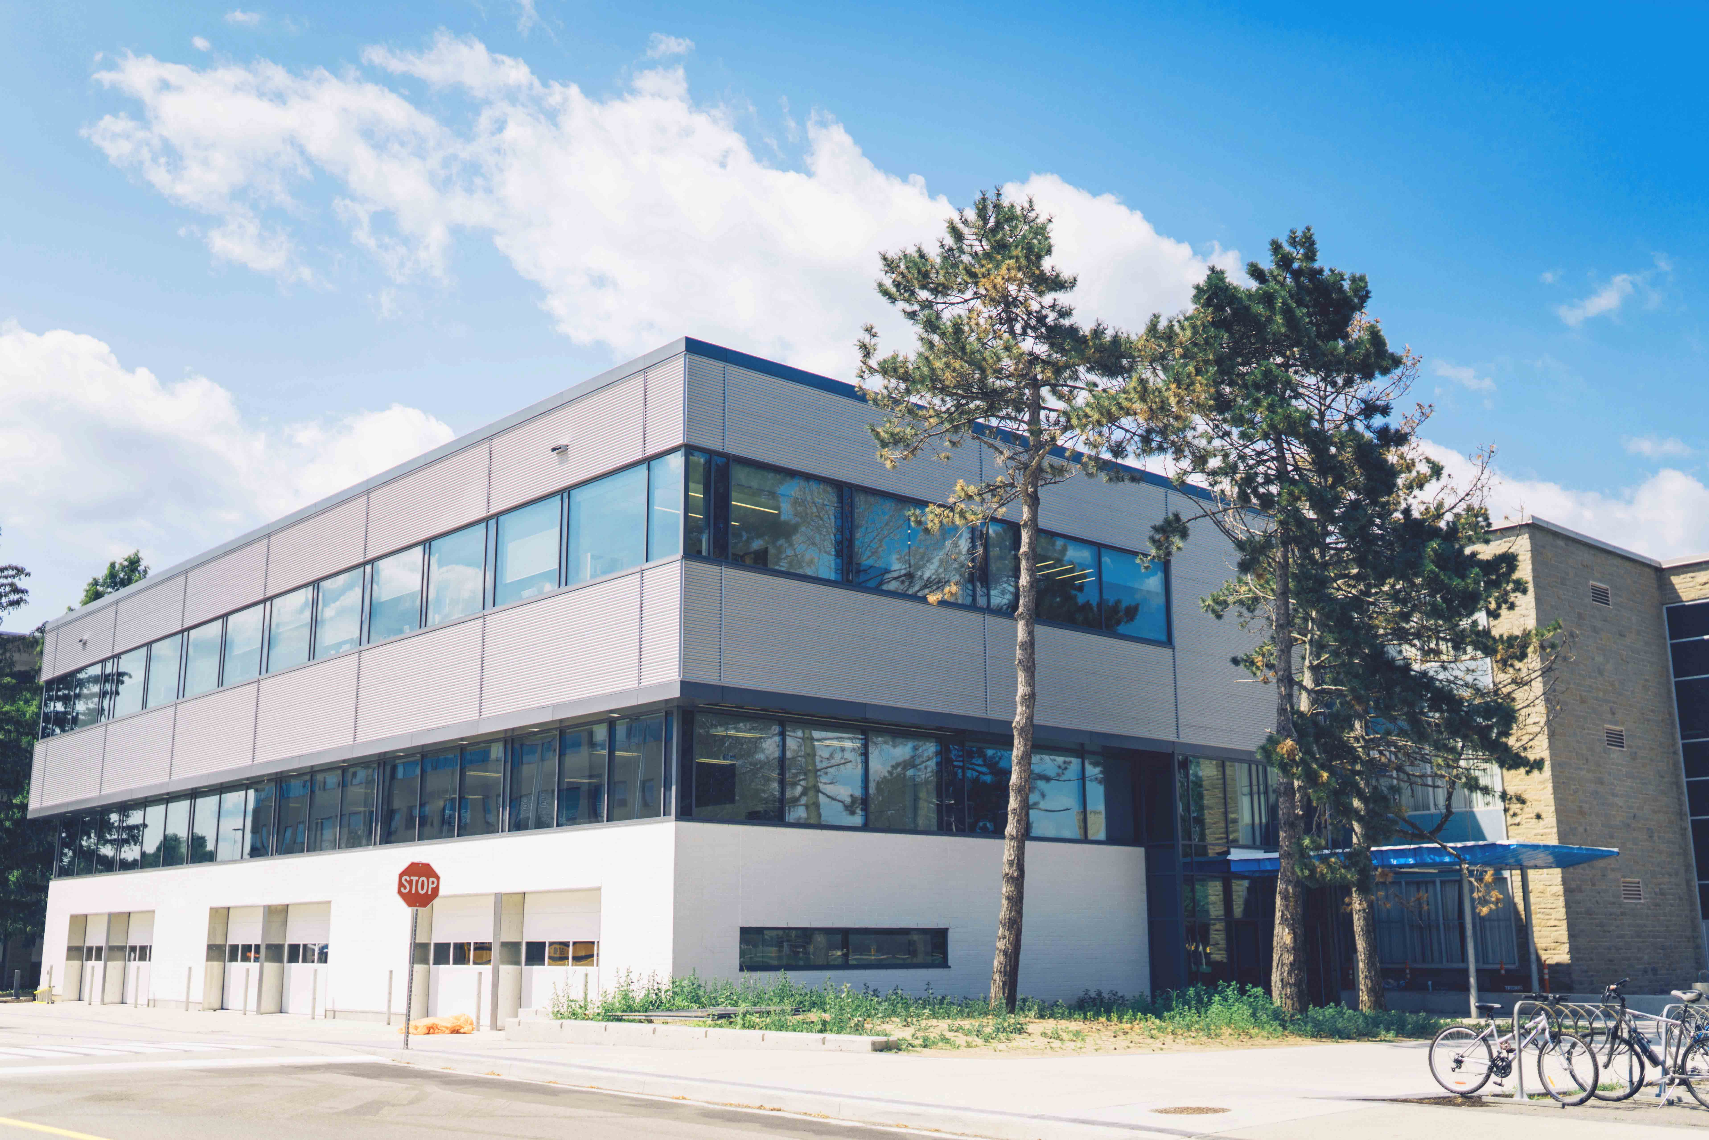
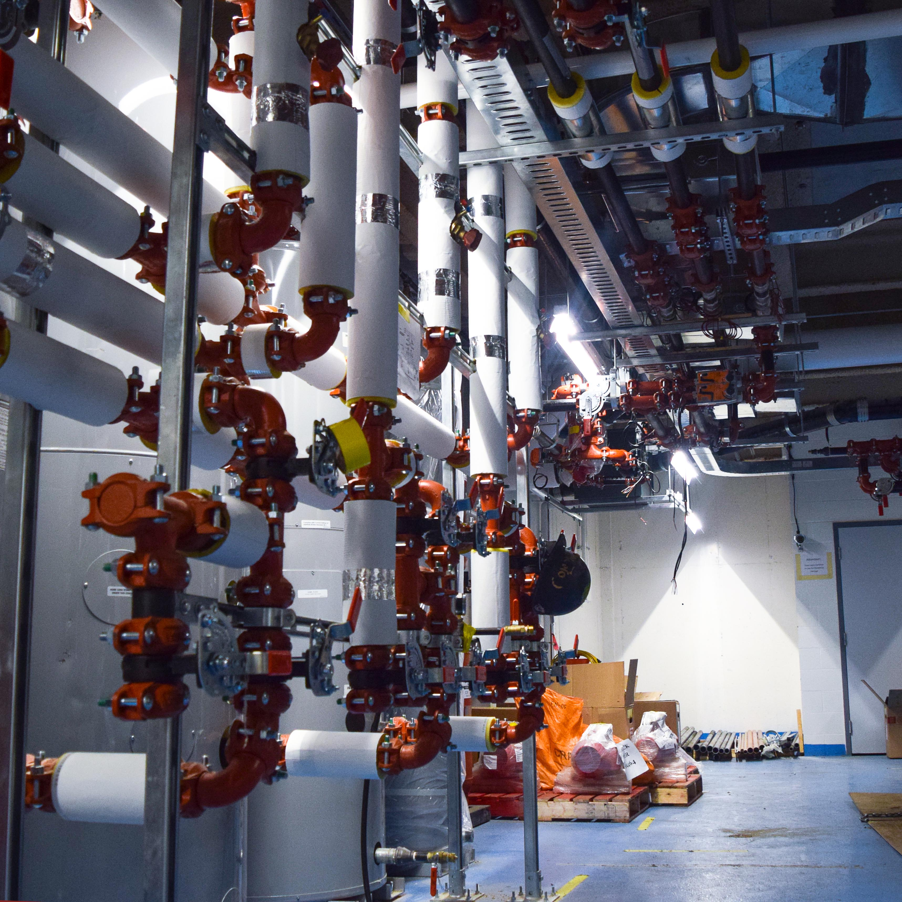
ICE Harvest Facility
28

Slide 5



Overview of project
28

Slide 6
Overview of project
Python connects to and requests information stored in MySQL database
28

Slide 7
Overview of project
MySQL sends data requested and is stored in Python
28

Slide 8
Overview of project
Python sends parameters to a Modelica model
28

Slide 9
Overview of project
Modelica simulates and returns the simulation results back to python
28

Slide 10
Overview of project
The data then can be arranged with other python libraries:
MySQL
Excel
Text file
Can be saved in graphical form:
Matplotlib
Any other Python graphics library
28

Slide 11
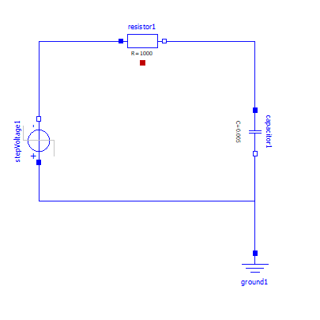
Modelica Model
Simple RC circuit connected to a step voltage was used
Any model can replace this simple model with a different database of parameters easily
28

Slide 12
Database information
 | Voltage | Resistance | Capacitance
Case 1 | 120 | 10 | 0.005
Case 2 | 120 | 100 | 0.005
Case 3 | 120 | 300 | 0.005
A MySQL database with the rows above is on the server that will be accessed
These cases will show the difference that resistance has in the model
28

Slide 13

Output software
Using matplotlib to show results graphically
To display:
Voltage across the resistor vs time
Current across the resistor vs time
28

Slide 14
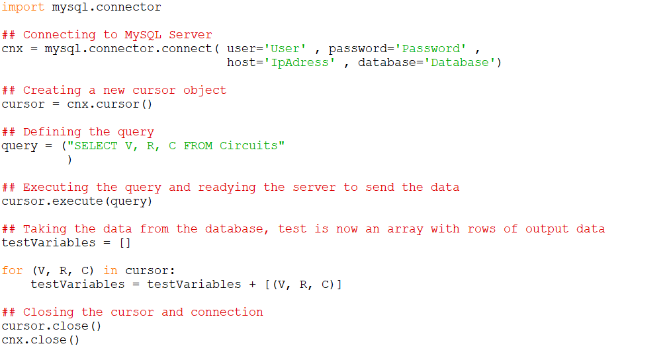
Python to MySQL data transfer
28

Slide 15
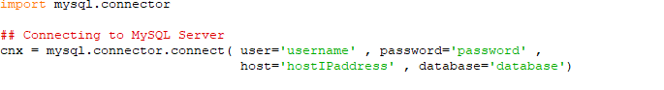
Connecting to your database
Accesses a user with reading privileges to the database
Connects to the server holding the test parameters
Specifies the database where the tables of test parameters are held
28

Slide 16
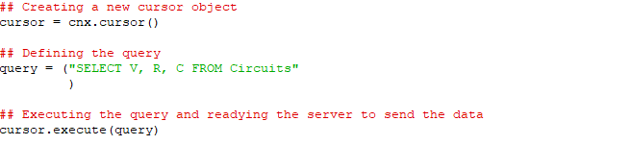
Executing a search of the database
Creates a cursor object that will perform the query and hold the results
Defines the query to be sent to the database
This query can use expressions to specify the results desired
Executes the query and prepares the database to send the results
28

Slide 17
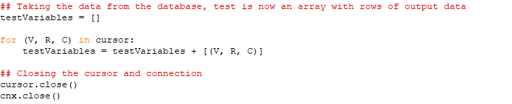
Taking the parameters out of the database
The parameters are then stored in variable
The MySQL connection is then closed
28

Slide 18
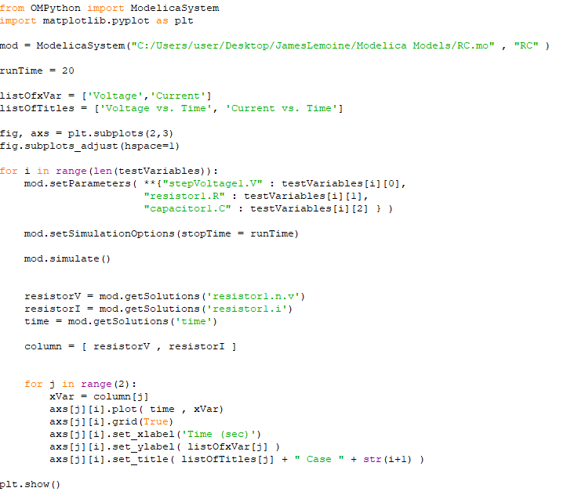
Python and OpenModelica data transfer
28

Slide 19

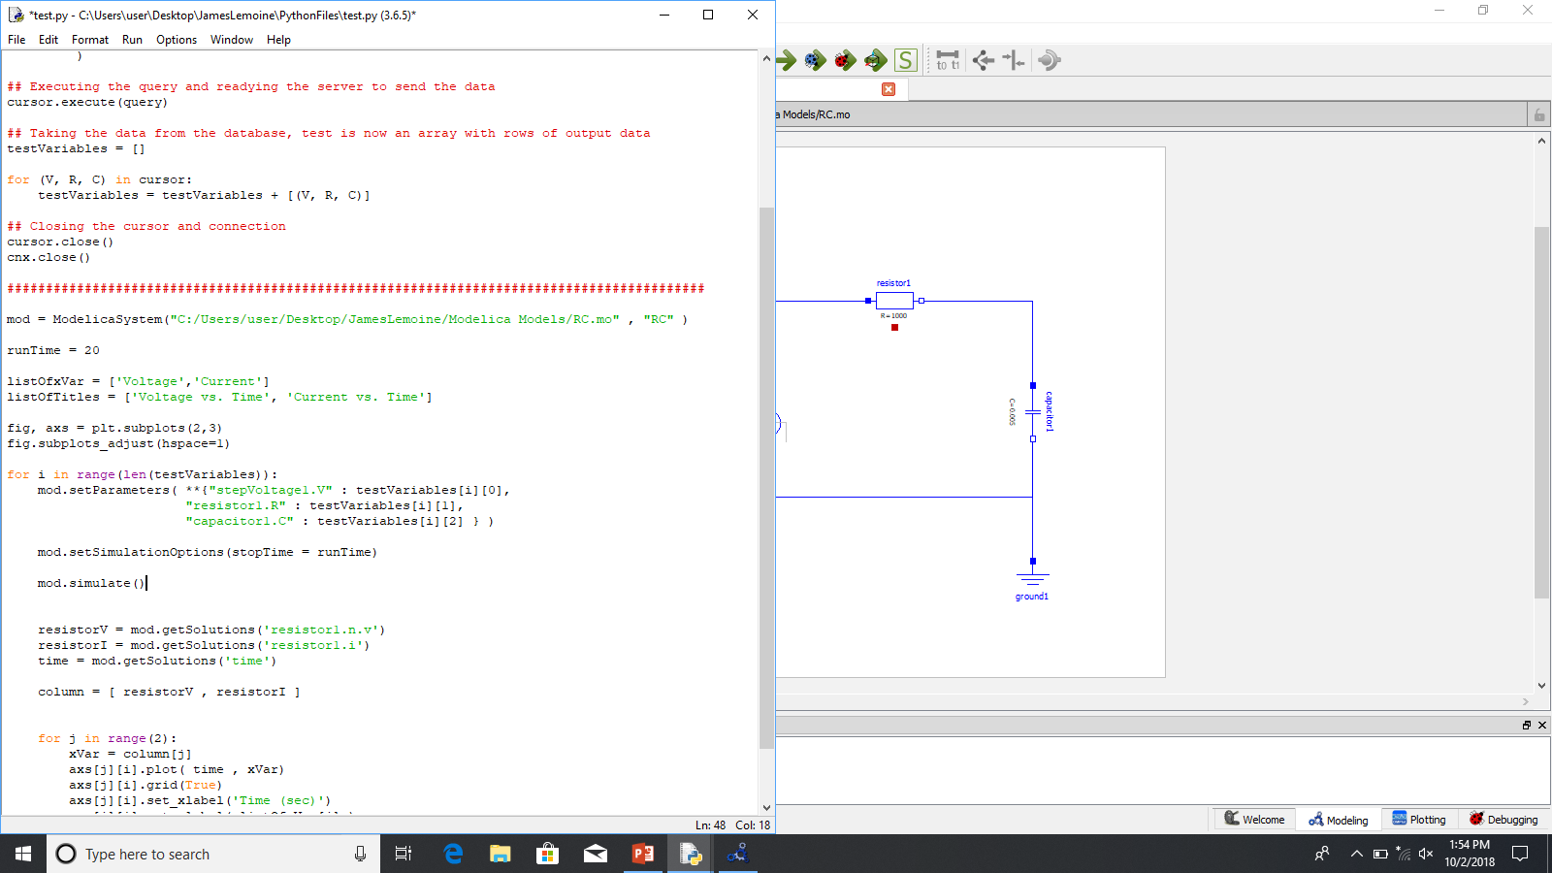
Loading the model
The specific model can be loaded by giving the directory it was saved and the model name
This also loads the Modelica Standard library
Run time is stored as 20 seconds
This can be done later to change the run time of each set of parameters
28

Slide 20
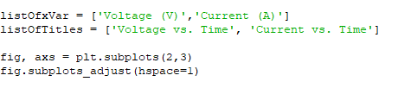
Preparing for outputting data
Setting up for the final data manipulation
Setting up the axis and chart titles
Making subplots to show all graphs on one figure
28

Slide 21

Simulating model
Inputting the parameters saved in the array into the Modelica model
Changing the runtime to the time set before
Simulating each model
28

Slide 22

Retrieving solutions
* Still under previous for loop
After each model is simulated the solutions are taken out and an array is made
From this point the data may be output into a spreadsheet
28

Slide 23

Plotting solutions
* Still under the for loop
Here the solutions are plotted
A column of the subplot is given for each case
Runs two times per simulation to make both subplots that are desired
After both loops the final figure is shown
28

Slide 24
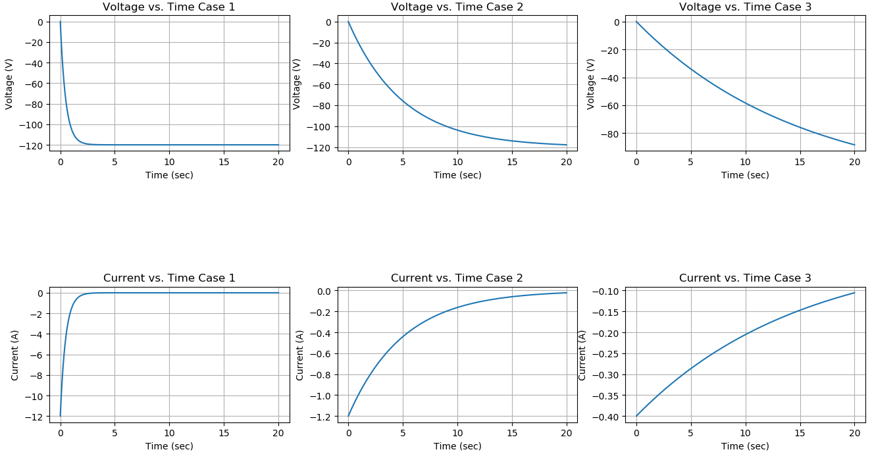
Output graphical window
28

Slide 25
Future goals
The project is to be adapted for models of HVAC machinery
Efficiency tables given from the manufacturers will be transferred into the Modelica models
28

Slide 26
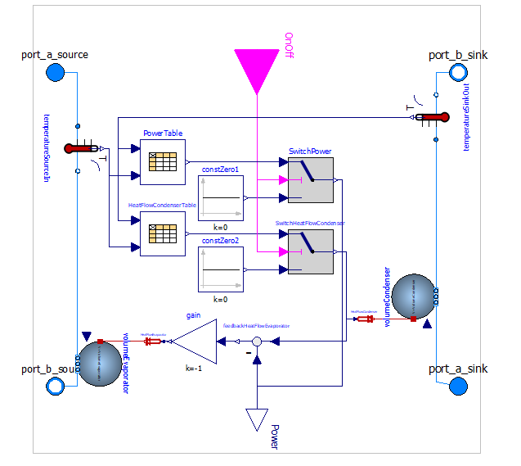
Simple heat pump model from AixLib
28

Slide 27
Simple heat pump model from AixLib
28

Slide 28
Thank you
28

